Slide 1


Minor Project
Title: Tour Planner
Presented by:
R177219209- Vanshika Parashar
R177219178- Somya Sharma
R177219143- Rajneesh
R177219170- Shantanu Jaswal
Mentored By:
Mr. Deepak Kumar Sharma

Slide 2
CONTENT
Introduction
Literature Review
Objectives
Methodology
Working Model
Results
Conclusion
References

Slide 3
INTRODUCTION
Problem Statement: The problem statement that we are addressing in this project is whenever a tourist plans to travel to an unknown city or a state, his or her most of the time is wasted in planning the best route.
Target Beneficiary: Tour planning is a challenging task for individuals visiting unfamiliar tourist destinations. Planning the perfect route so that the cost of traveling is minimal and fast as time is a major factor in traveling cities we want to travel.
Project Scope: Our idea is to have comparative analysis of shortest route algorithms designed to help all kinds of tourists. In our application, the solution to the above problem can be a proper application that gives us the shortest path between two options namely single trip (source to destination) and round trip (source to source after visiting all destinations).

Slide 4
LITERATURE REVIEW
Dijkstra (1959) has proposed an algorithm which examines all the nodes adjacent to the most recently evaluated node on the path[1]. The closest to the origin node are evaluated first, and the most distance nodes are evaluated last[2].
Bellman ford algorithm is a single-source shortest path algorithm. This algorithm is used to find the shortest distance from the single vertex to all the other vertices of a weighted graph[6], unlike the Dijkstra Algorithm, the Bellman-Ford algorithm can work on graphs with negative-weighted edges. This capability makes the Bellman-Ford algorithm a popular choice.[3]
A literature survey of this algorithm focuses on transportation network would be quite helpful for any research related to dynamic Route Guidance systems (RGS). Route guidance helps us in providing the path directions based on changing traffic conditions[4].
Given a set of origin-destination (O/D) pairs, there could be many possible routes for a driver. A useful routing system should have the capability to support the driver effectively in deciding on an optimum route to his preference[3].
Reference from websites like programmingsimplified.com and developerinsider.com, to get the basic idea of Graphical User Interface.[4]

Slide 5
OBJECTIVE
To design a shortest path between cities using various algorithms:
Dijkstra Algorithm
Bellman-Ford Algorithm
Floyd warshall Algorithm
Johnson’s Algorithm
Perform Comparative Analysis between these algorithms.

Slide 6
METHODOLOGY
First we will create a graph of places to visit using matrix representation, taking distance as a cost between the nodes.
Then for single trip we apply various algorithms like Dijkstra’s, Bellman-Ford, Floyd-Warshall and Johnson’s, for finding shortest path between source and destination.
We will be taking the input from the flat-file and work on that dataset.

Slide 7
Workflow
Start
main screen with options
if option == “round trip”
Window of trending destinations
Window displaying list of source which is to be selected by user
Pressing any key results back to main screen
if option==”single trip”
Window displaying list of source which is to be selected by user
Window displaying list of destinations which is to be selected by user
Dijkstra() function is called and output is displayed to the user
Pressing any key results back to main screen
if option==”user manual”
A text which gives idea of our application
Pressing any key results back to main screen
if option==”about”
A text which shows developers details
Pressing any key results back to main screen
if option==”exit”
EXITS OUT OF APPLICATION
END

Slide 8
ALGORITHMS
Dijkstra algorithm:- Given a graph and a source vertex in the graph, find the shortest paths from the source to all vertices in the given graph.
Bellman-Ford Algorithm:- Given a graph and a source vertex source in graph, find shortest paths from source to all vertices in the given graph. The graph may contain negative weight edges.
Floyd Warshall:- The problem is to find shortest distances between every pair of vertices in a given edge weighted directed Graph
Johnson’s:- The problem is to find shortest paths between every pair of vertices in a given weighted directed Graph and weights may be negative. Johnson’s algorithm uses both Dijkstra and Bellman-Ford as subroutines.

Slide 9
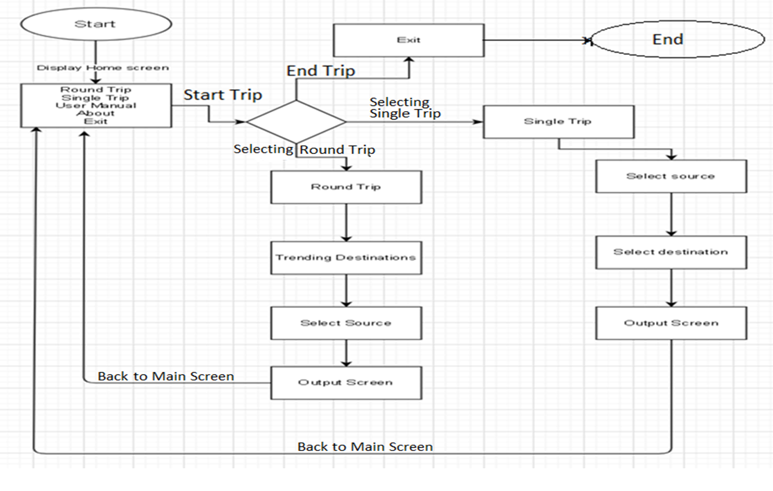
FLOWCHART

Slide 10
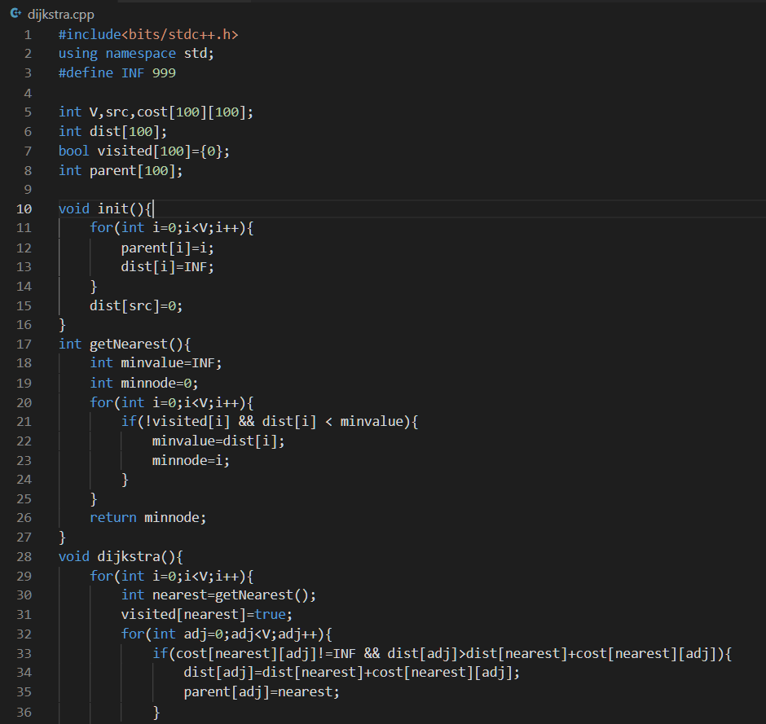
DIJKSTRA IMPLEMENTATION

Slide 11
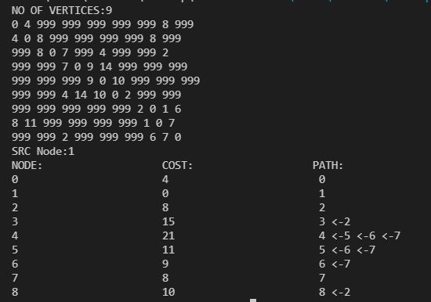
OUTPUT

Slide 12
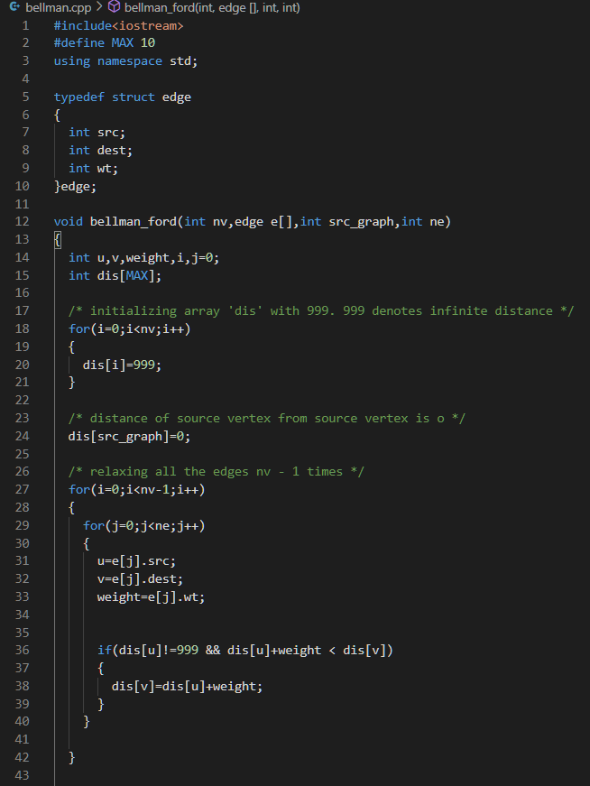
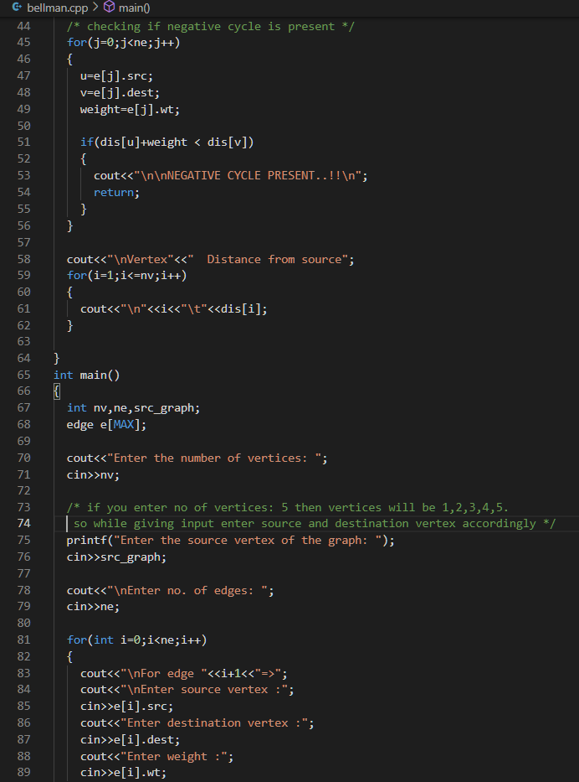
BELLMAN-FORD IMPLEMENTATION

Slide 13
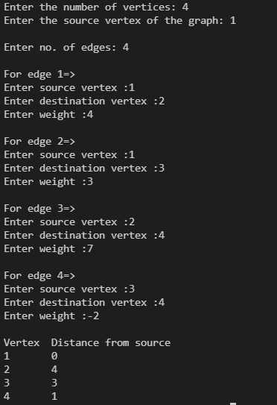
OUTPUT

Slide 14
CONCLUSION
Dijkstra's algorithm is better when it comes to reducing the time complexity. However, when we have negative weights, we have to go with the Bellman-Ford algorithm. Also, if we want to know whether the graph contains negative cycles or not, the Bellman-Ford algorithm can help us with that.
Future Scope:
Analysing two more algorithms, Floyd Warshall and Johnson’s algorithm. Based on time complexity and space complexity.
Finding the best algorithm to use for such application.
Making a Graphic User Interface for the user.

Slide 15
Reference
https://www.geeksforgeeks.org/dijkstras-shortest-path-algorithm-greedy-algo-7/
https://www.programiz.com/dsa/dijkstra-algorithm
http://www.cs.rpi.edu/~musser/gp/algorithm-concepts/bellman-ford-screen.pdf
https://developerinsider.co/graphics-graphics-h-c-programming/
https://www.sciencedirect.com/topics/computer-science/dijkstra-algorithms
https://www.baeldung.com/cs/bellman-ford

Slide 16
Thank You

